Slide 1

Data Management and the Data Life Cycle
Jeffery S. Horsburgh
Hydroinformatics
Fall 2016
This work was funded by National Science Foundation Grants EPS 1135482 and EPS 1208732

Slide 2
Objectives
Describe the data life cycle
Provide a more holistic view of data management
Introduce data management techniques that:
Improve data organization
Facilitate analysis
Improve reproducibility
Improve capacity for data re-use

Slide 3
The Data Life Cycle
Assure
Preserve
Discover
Integrate
Analyze
Plan
Describe
Collect
Slide courtesy DataONE.

Slide 4
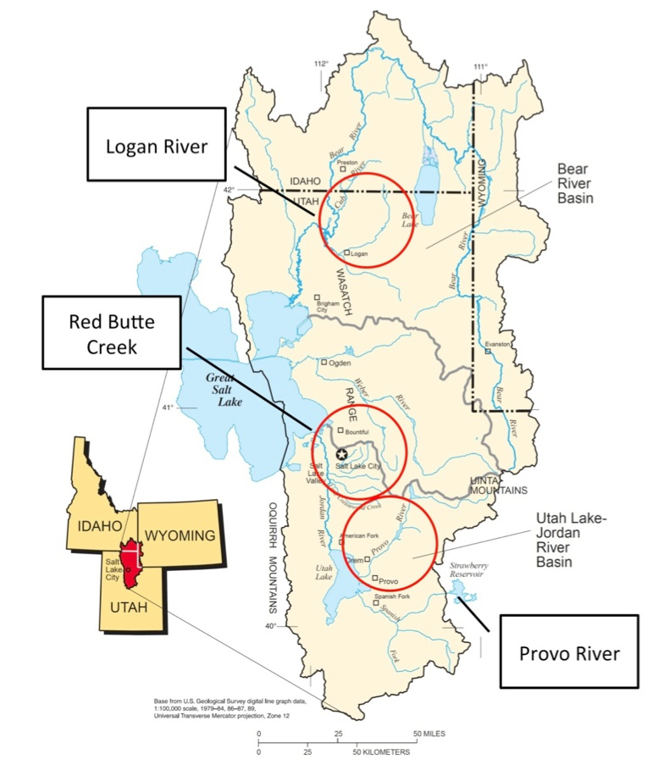
Gradients Along Mountain To Urban Transitions (GAMUT) Network
Ecohydrologic observatory deployed in 3 watersheds in northern Utah, USA: Logan River, Red Butte Creek, Provo River
Watersheds with similar water source (high elevation snow) but different land use transitions
Measures aspects of water inputs and outputs and water quality over mountain-to-urban gradient
Mix of aquatic and terrestrial in situ and re-locatable sensors

Slide 5
The Data Life Cycle
Start here
Assure
Preserve
Discover
Integrate
Analyze
Plan
Describe
Collect

Slide 6
Planning
Consider Data Management Before You Collect
What research questions will you answer?
What kind of data will be collected?
Which methods will be used (sensors, samples, etc.)?
What data formats/standards are appropriate?
How will the data be used?
How will you share the data?
Will your methods satisfy
Funding requirements
Policies for access, sharing, reuse
Budget – most of the time data management is overlooked!!

Slide 7
Data Management Plan
Formal document
Outlines what you will do with your data during and after your research
Can be an agreement among collaborators on how data will be managed
Can save you time and money in the long run
Meet the requirements of data centers and repositories by design instead of afterthought
Required by many research funding agencies!

Slide 8

NSF DMP Requirements
From Grant Proposal Guidelines:
Plans for data management and sharing of the products of research. Proposals
must include a supplementary document of no more than two pages labeled “Data Management Plan”. This supplement should describe how the proposal will
conform to NSF policy on the dissemination and sharing of research results (in
AAG), and may include:
the types of data, samples, physical collections, software, curriculum materials, and other materials to be produced in the course of the project
the standards to be used for data and metadata format and content (where existing standards are absent or deemed inadequate, this should be documented along with any proposed solutions or remedies)
policies for access and sharing including provisions for appropriate protection of privacy, confidentiality, security, intellectual property, or other rights or requirements
policies and provisions for re-use, re-distribution, and the production of derivatives
plans for archiving data, samples, and other research products, and for preservation of access to them
Slide courtesy DataONE.

Slide 9
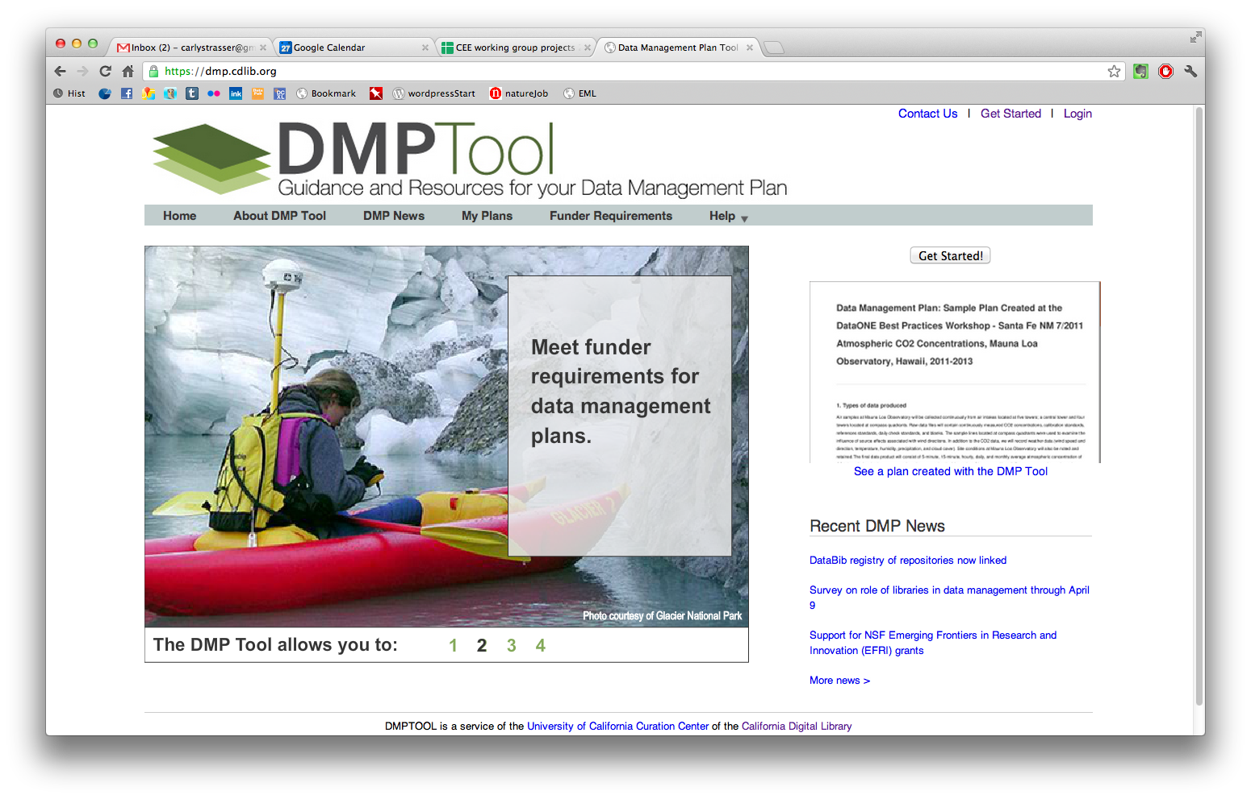
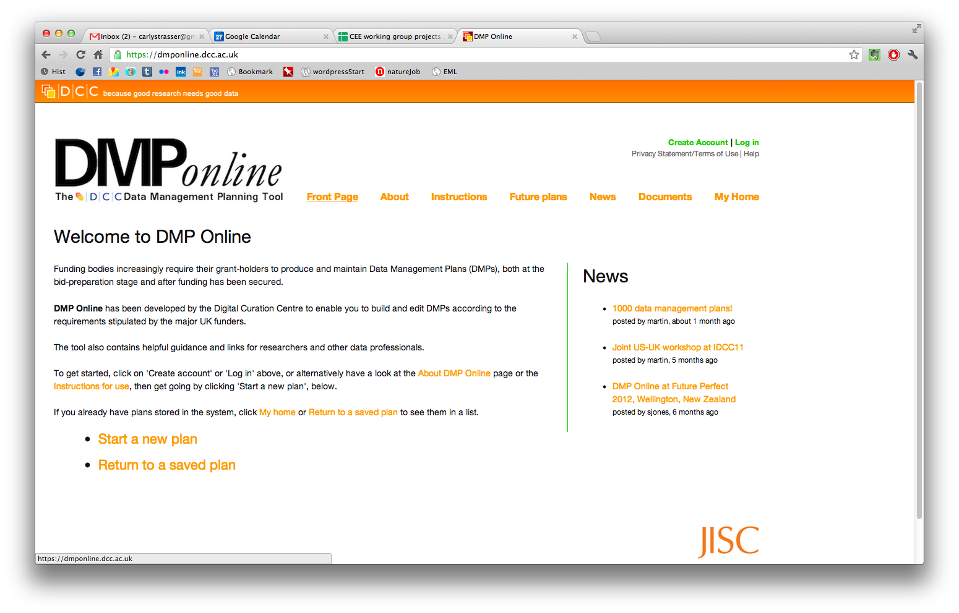
Tools for Creating Data Management Plans
University of California Curation Center of the California Digital Library
dmp.cdlib.org
Create ready-to-use data management plans for specific funding agencies
dmponline.dcc.ac.uk
Build and edit DMPs according to requirements of major UK funders.

Slide 10
The Data Life Cycle
Assure
Preserve
Discover
Integrate
Analyze
Plan
Describe
Collect

Slide 11
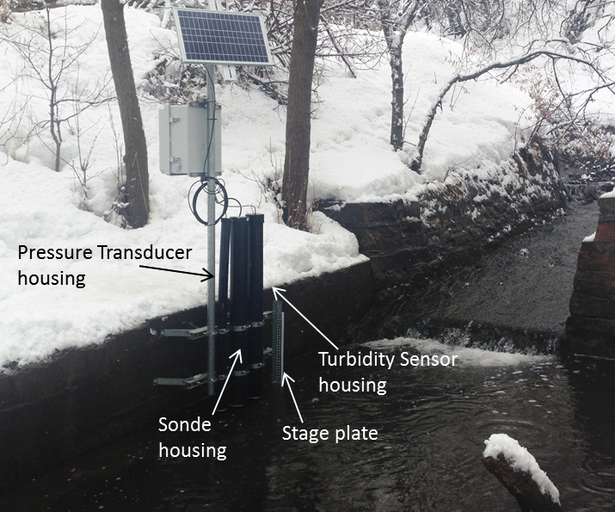
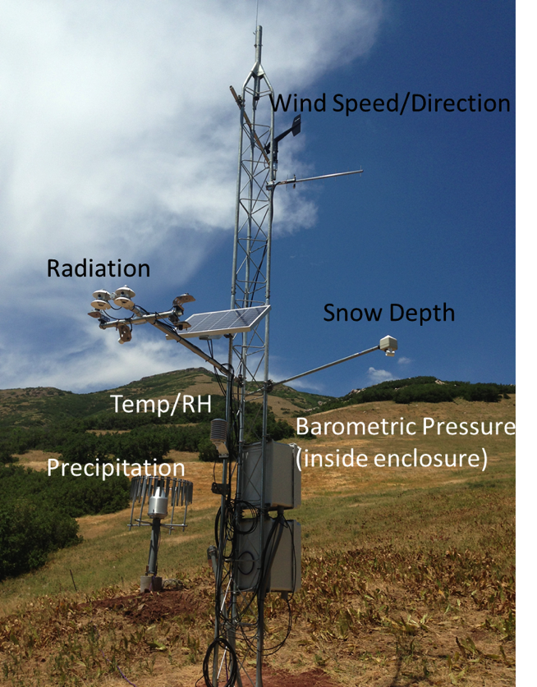
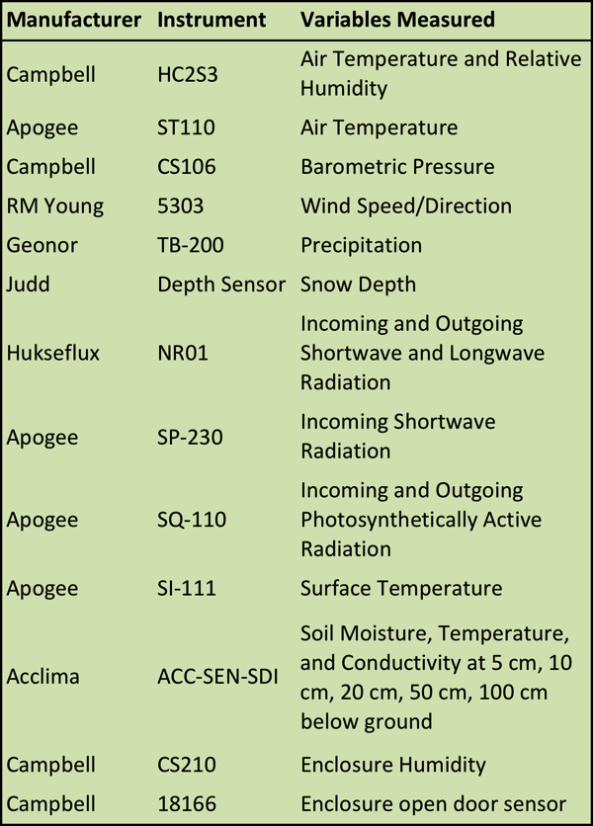
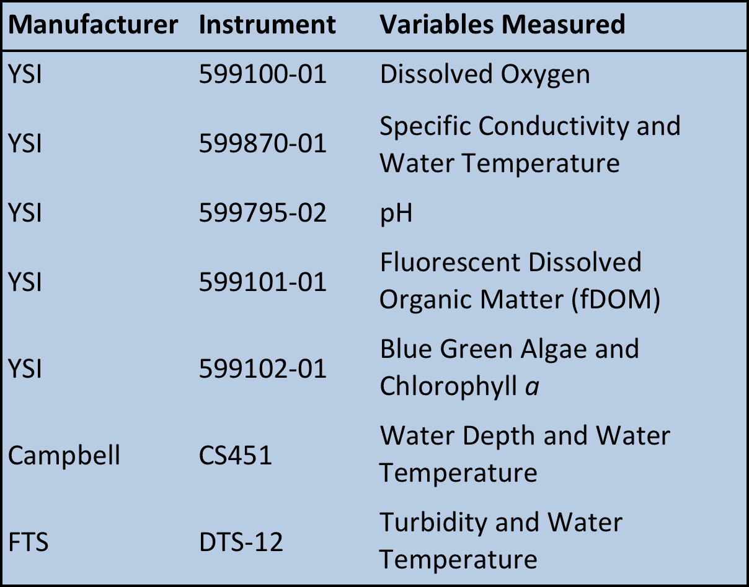
Gradients Along Mountain to Urban Transitions (GAMUT) Network
Aquatic Sites
Climate/Terrestrial Sites

Slide 12

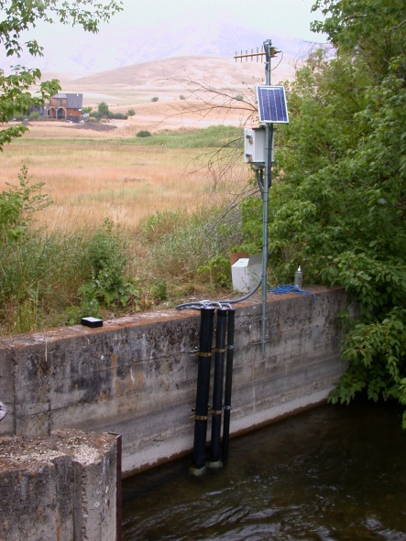
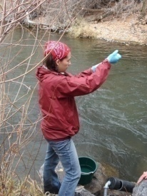
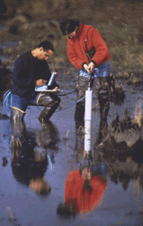
Collect
What are some ways that we produce data?
Experiments, observations, samples, model outputs, etc.
Varying frequency, temporal and spatial coverage

Slide 13
GAMUT Data Workflow

Slide 14
Sensor Data Acquisition

Slide 15
Data Loading and Storage

Slide 16
The Data Life Cycle
Assure
Preserve
Discover
Integrate
Analyze
Plan
Describe
Collect

Slide 17
Assure
Strategies for preventing errors from entering datasets
Standard data entry forms
Pre-specification of formats, units, etc.
Activities to ensure quality during collection
Standard field and laboratory procedures
Automated range checks for sensor data
Activities to “clean” collected data
Common to sensor data streams
Dependent upon variable and sensor
Graphical and statistical summaries

Slide 18
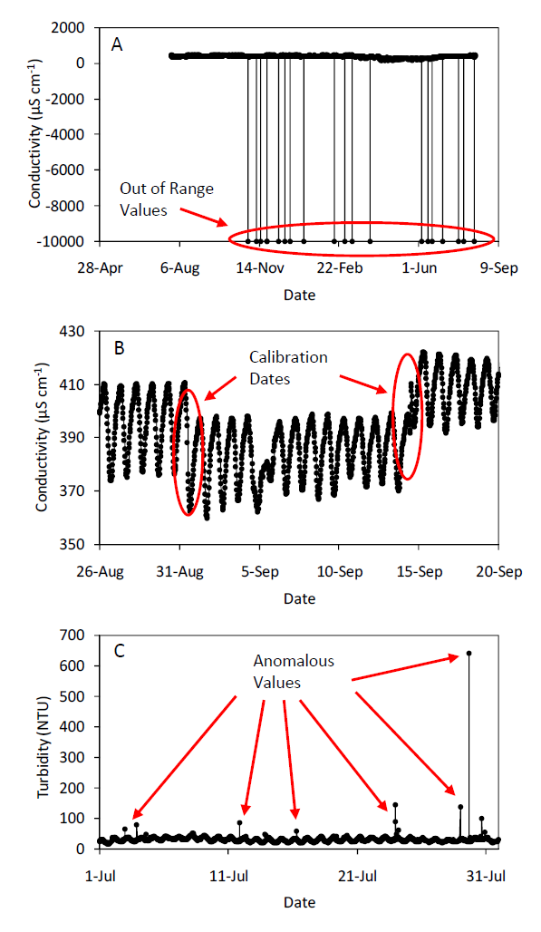
Assure
Out of range values
Sensor drift
Anomalous values

Slide 19
Sensor Data QAQC
Notes:
QA: off of this workflow

Slide 20
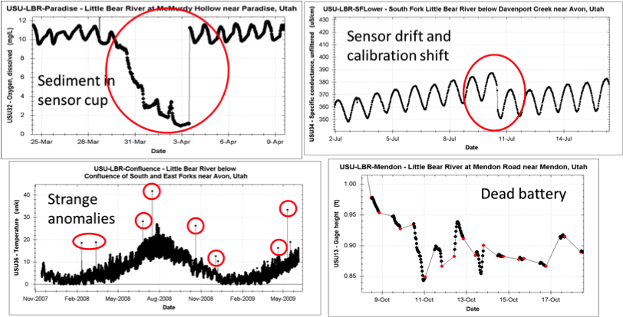
Development of a QAQC Plan
Quality Assurance:
“…protocols developed and adhered to in a way that minimizes inaccuracies in the data produced … produces high-quality data while minimizing the need for corrective measures to improve data quality.”
Site Standardization
Data Curation (Datalogger Programs and Files, Data Averaging, Database Structure, Equipment Management)
Replicate Sensors
Factory Maintenance
Field Maintenance Schedule and Procedures
Field Calibration Schedule and Procedures
Manual Data Monitoring
Automated Data Monitoring and Alerts
Recording Events
Quality Control:
“occurs after the data are generated and tests whether they meet the necessary requirements for quality outlined by the end users.”
Data Qualifiers and Flagging
Post Processing and Editing Data
Quality Control Levels/Versions
Data Processing Steps
Campbell, J. L., Rustad, L. E., Porter, J. H., Taylor, J. R., Ethan, W., Shanley, J. B., … (2013). Quantity is Nothing without Quality. BioScience, 63(7), 574–585. doi:10.1525/bio.2013.63.7.10
Notes:
Working on development of a QAQC plan to standardize protocols for QA (steps implemented prior to the collection of data) and QC (practices after the data are collected) of the data across the network.
QA: Includes many of the practices implemented in the network design. Also need plans for and standardization in field and factory maintenance.
QC: Consistent ways of implementing data flags and qualifiers and steps for data post-processing

Slide 21
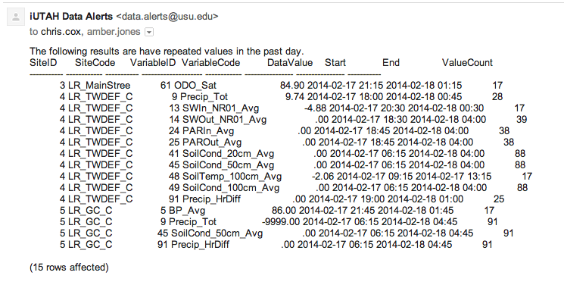
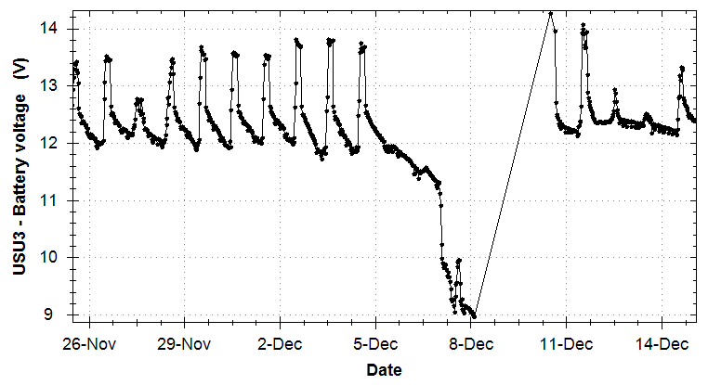
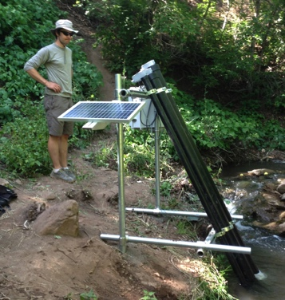
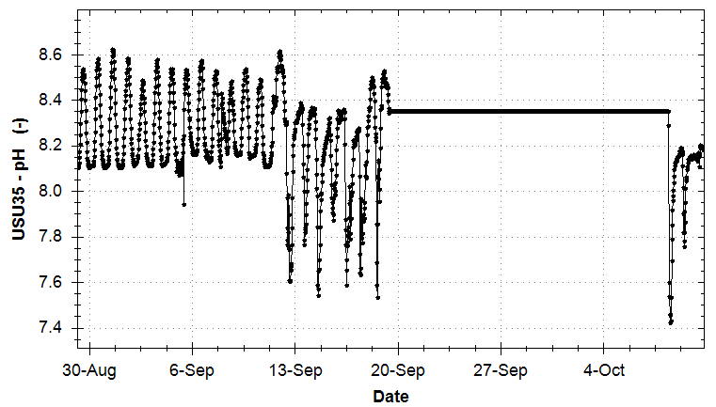
QAQC: Automated Alerts
Technicians receive email alerts daily
Power: battery voltage < 12 volts
Persistence: value of a variable is unchanging
Updates: data are not being reported
NaNs: sensor is reporting “NaN” values
Additional alerts will be implemented as needed (e.g., variable-specific range checks, internal consistency, spatial consistency).
Must…fix…sensor…
Streaming Data Loader
Observations Database
Alert!!
Alert Generator

Slide 22
The Data Life Cycle
Assure
Preserve
Discover
Integrate
Analyze
Plan
Describe
Collect

Slide 23
Describe
Metadata
Documentation and reporting of data
Contextual details
What is it critical to know about the data?
Description of temporal and spatial details, instruments/sensors, methods, units, files, etc.

Slide 24
Metadata Content and Format
What metadata are needed?
Details that make data meaningful
How will metadata be created
Lab notebooks?
Automatically generated by a sensor or instrument?
What format will be used for the metadata?
Standards may be chosen by community or dictated by an agency

Slide 25
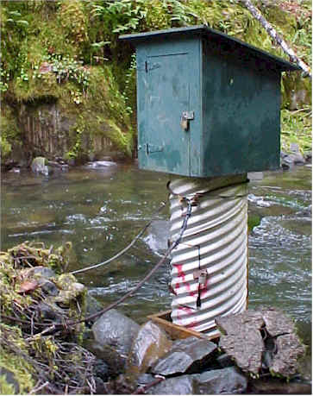
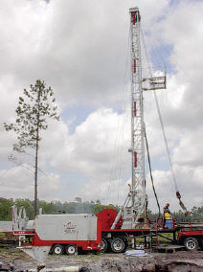
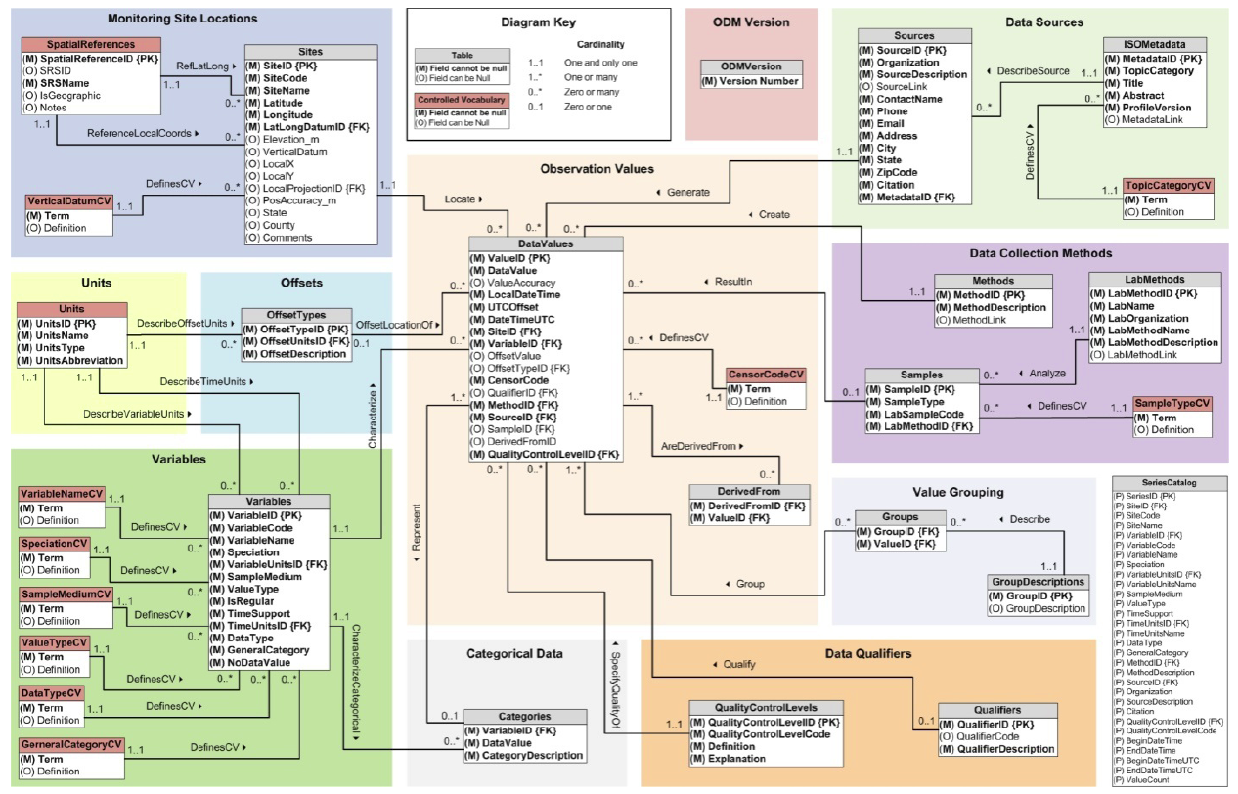
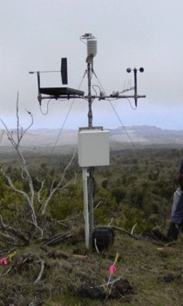
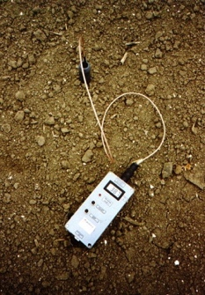
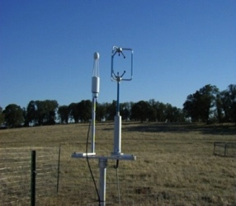
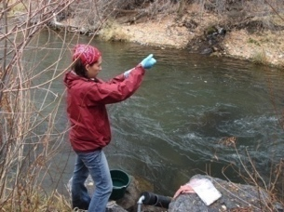
Observations Data Model (ODM)
Groundwater
levels
Streamflow
Precipitation
& Climate
Soil moisture
data
Flux tower data
Water Quality
A relational database at the single observation level
Metadata for unambiguous interpretation
Traceable heritage from raw measurements to usable information
Promote syntactic and semantic consistency
Cross dimension retrieval and analysis
Horsburgh, J. S., D. G. Tarboton, D. R. Maidment, and I. Zaslavsky (2008), A relational model for environmental and water resources data, Water Resources Research, 44, W05406, doi:10.1029/2007WR006392.
Notes:
The Observations Data Model is a framework for storing and describing point-based data.
Provides metadata for sites, variables, methods, etc.
Community standard, widely-implemented, standard vocabularies, tools built to interact with ODM.

Slide 26
The Data Life Cycle
Assure
Preserve
Discover
Integrate
Analyze
Plan
Describe
Collect

Slide 27
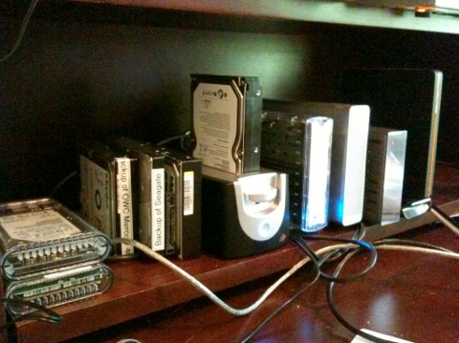
Preserve
How are you preserving your data now?
Does Your Office Look Like This?
What are the potential problems?
What are some potential solutions?

Slide 28
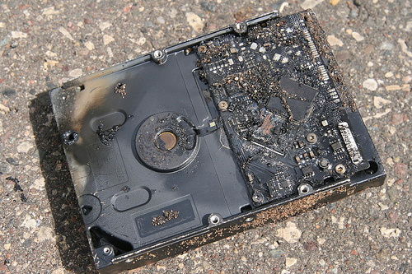
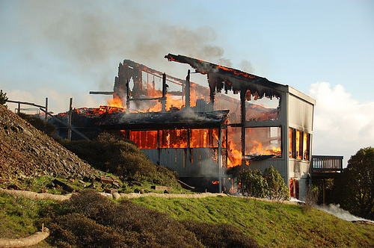
Data Loss
Natural disaster
Facilities infrastructure failure
Storage failure
Server hardware/software failure
Application software failure
External dependencies
Format obsolescence
Legal encumbrance
Human error
Malicious attack by human or automated agents
Loss of staffing competencies
Loss of institutional commitment
Loss of financial stability
Changes in user expectations and requirements
CC image by Sharyn Morrow on Flickr
CC image by momboleum on Flickr
Slide courtesy DataONE.

Slide 29
GAMUT Data Archival

Slide 30
The Data Life Cycle
Assure
Preserve
Discover
Integrate
Analyze
Plan
Describe
Collect
We will cover these later on this semester

Slide 31
The Data Life Cycle Summary
Stages thru which well-managed data passes from the inception of a research project to its conclusion
The stages do not always follow a continuous circle
Assure
Preserve
Discover
Integrate
Analyze
Plan
Describe
Collect

Slide 32
Data Management 101
Simple guidelines to improve data management
Benefits
Improved data organization – facilitates analysis
Improved reproducibility
Improved capacity for data re-use
Borer, E.T., E.W. Seabloom, M.B. Jones, and M. Schildhauer (2009). Some simple guidelines for effective data management, ESA Bulletin, 90(2):205-214, http://dx.doi.org/10.1890/0012-9623-90.2.205

Slide 33
1. Don’t Mess with the Raw Data
Always store uncorrected data with all of its “bumps and warts”
Do not make any corrections to this
You could change something that was actually correct
You could make mistakes while correcting other mistakes
Script QA/QC procedures and write results to a new file/copy of the data

Slide 34
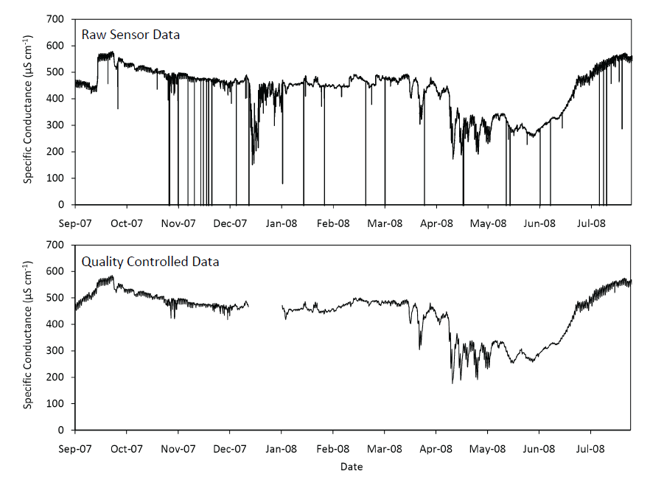
An Example

Slide 35
2. Use Descriptive File Names
Use only plain ASCII characters
Brief, but descriptive of content
Generally – avoid spaces in file names
Include a “readme” file when using many files in a directory

Slide 36
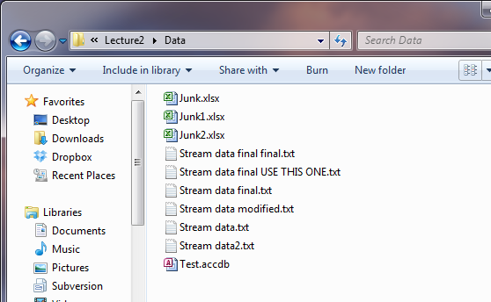
This might not be the best system…
How could we make this better?

Slide 37
3. Use Descriptive Headers in Files and Tables
Standard convention for many software applications
Excel understands that the first line in a file is the header line
Subsequent lines are interpreted as data
Encapsulate data and descriptive metadata together

Slide 38
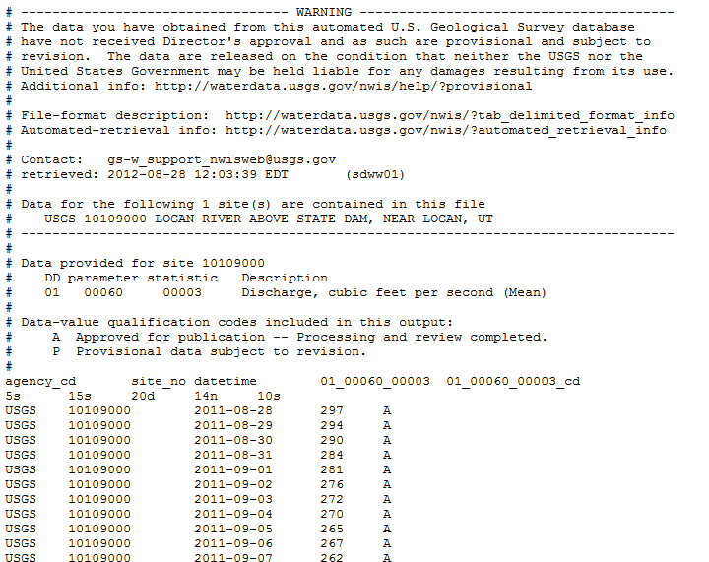
Streamflow Data from USGS

Slide 39
4. Do Not Mix Data Types in Table Columns
Numeric, strings, date/time, boolean
Most analysis software will not “handle” mixed data types
Different software packages will handle mixed data types inconsistently
Can be more difficult to detect errors in the data

Slide 40
5. Archive Data in Non-Proprietary Data Formats
Microsoft Excel is widely available and used now, but what about in 10 years? 20 years?
How many other software programs can open your data?
Will your data disappear if the file format/software become obsolete?

Slide 41
What format to use?
Store it in a file format that can be used by many different software programs
Text files – e.g., comma separated values (CSV) for tabular data
Use a standard file format accepted by your scientific community
Consider both format and syntax (e.g., the structure within the file)

Slide 42
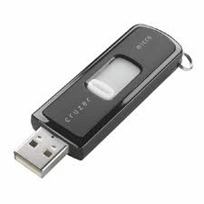

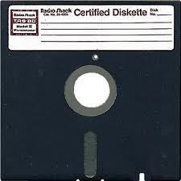
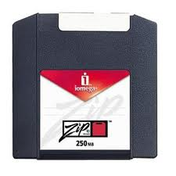
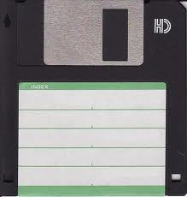
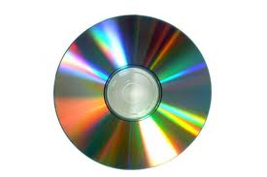
6. Consider Media
CDs?
DVDs?
External hard drives?
Don’t strand your data!!!
2000
1995
1976
1986
1994
1985

Slide 43


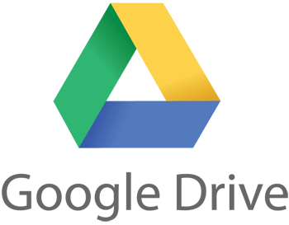
To the Cloud!
Convenience
Accessibility anywhere
Cross platform
Enhanced sharing
Low cost
But…
Privacy???????
Delay (slow or non-existent internet)
Storage, but not much else
File formats and semantics still matter
Disclaimer: Use of these logos is not authorized by, sponsored by, or associated with Microsoft, Google, or Dropbox.

Slide 44
7. Automate Analyses
Code creates reproducible results
Code is a record of the steps involved in processing and analyzing data
Code can be shared
Code can be re-executed at any time

Slide 45
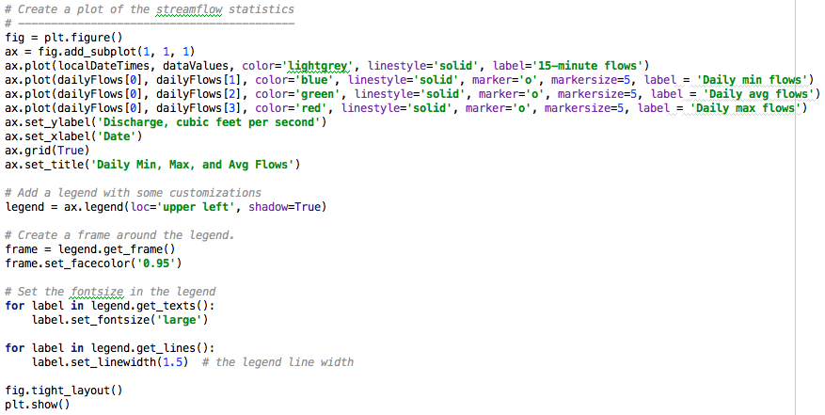
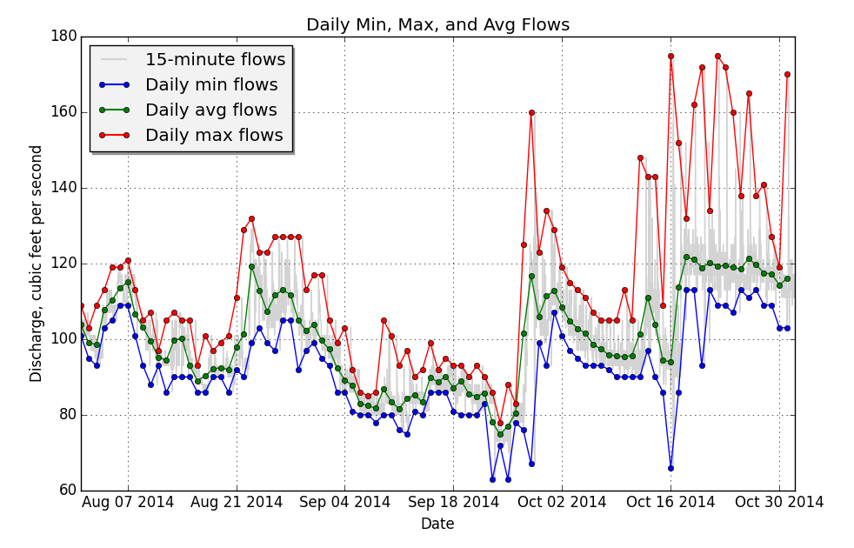
Reproducible Visualization in Python

Slide 46
8. Maintain Metadata
Borer et al.: “Do not underestimate your ability to forget details about a study!”
When did the tree that was stuck in my cross section get removed????
You may not analyze your data until years down the road
Exact details of methods, names, files, etc. will become fuzzy

Slide 47
What is Metadata?
Metadata is “Information about Data”
WHO created the data?
WHAT is the content of the data?
WHEN were the data created?
WHERE is it geographically?
WHY were the data developed?
HOW were the data developed?
Content, quality, condition, and other characteristics
Notes:
Greek --- with, about, between, or among; typically used as prefix to mean “one level of description higher”

Slide 48
The Purpose of Metadata
Support discovery of scientific data
Facilitate acquisition, comprehension, and use of data by HUMANS
Enable automated discovery, ingestion, processing and analysis by MACHINES
Notes:
There is a saying: “order is for the feeble minded only, while the genius masters the chaos” – not operationally practical…

Slide 49
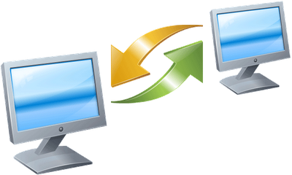
The Golden Rule of Sharing Data
When you provide data to someone else, what types of information would you want to include with the data?
When you receive a dataset from an external source, what types of details do you want to know about the data?

Slide 50
Data Management 101 Summary
Don’t mess with the raw data
Use descriptive file names
Use descriptive file headers
Do not mix data types in table columns
Archive data in non-proprietary data formats
Consider media
Automate analyses
Maintain metadata

Slide 51
Summary (1)
Considering the whole data life cycle is important in planning for a project or study
Data management planning helps satisfy institutional or funder requirements
Assuring data quality includes strategies before, during and after data collection

Slide 52
Summary (2)
Describing data via metadata is important for data discovery, interpretation, integration, and analysis
Relatively simple data management practices can improve data organization, facilitate analysis, improve reproducibility, and improve capacity for reuse

Slide 53
Intro to Assignment 1

